Slide 1
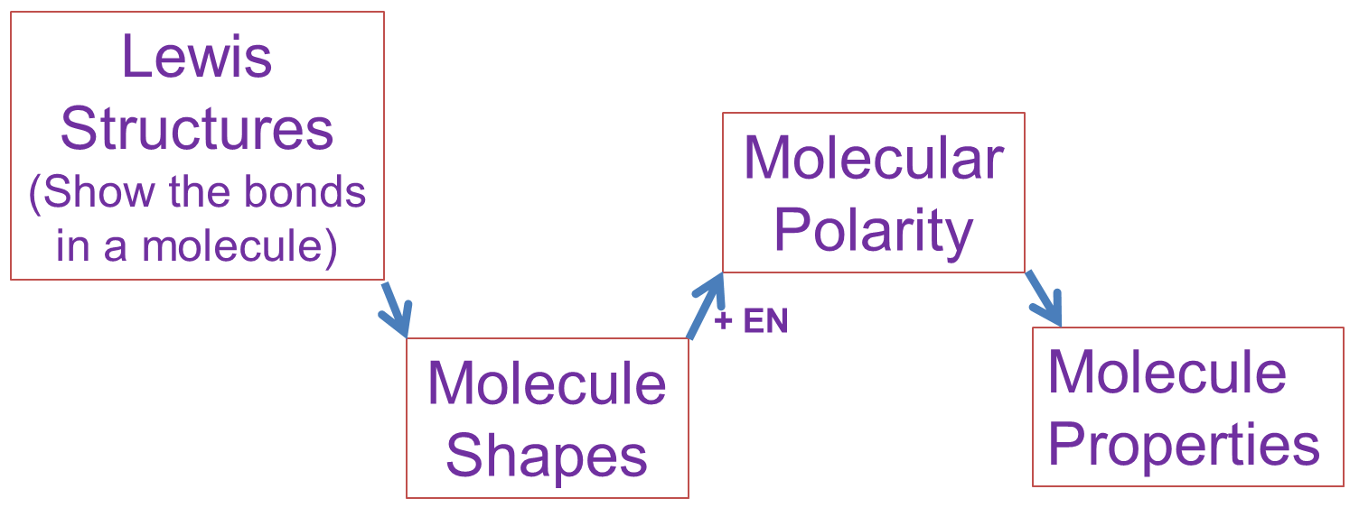
Group Activity/Intermittent Lecture
Put the following molecules in order of lowest Boiling Point to highest Boiling Point.
H₂O₂, CO₂, HCN
Boiling points will be higher when the molecules are more strongly attracted to each other in the liquid. Here’s how we figure it out. (Discuss and draw each step with your group.)
+IMFs
Step 1

Slide 2
Best Practices for Drawing Lewis Structures of molecular compounds & polyatomic ions
Draw the molecule’s “Skeleton”
Central atom is usually least EN or “odd element” (never hydrogen)
Count Valence Electrons
Place electrons on molecule in pairs, starting with outer elements to give each atom an octet (duet for hydrogen).
If a central atom does not have a full octet, move lone pairs in as bonds.

Slide 3
Lewis Structures
Put the following molecules in order of lowest Boiling Point to highest Boiling Point.
H₂O₂, CO₂, HCN
Lewis
Structures
(Show the bonds in a molecule)
Molecular
Polarity
+IMFs
+ EN
Molecule
Shapes
Molecule
Properties
Step 2

Slide 4
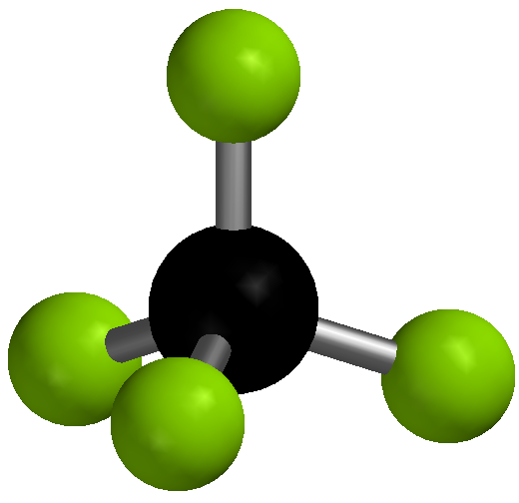
VSEPR Theory (Shapes of Molecules)
valence shell electron pair repulsion theory -Electron groups around the central atom will be move as far apart as possible.
4

Slide 5
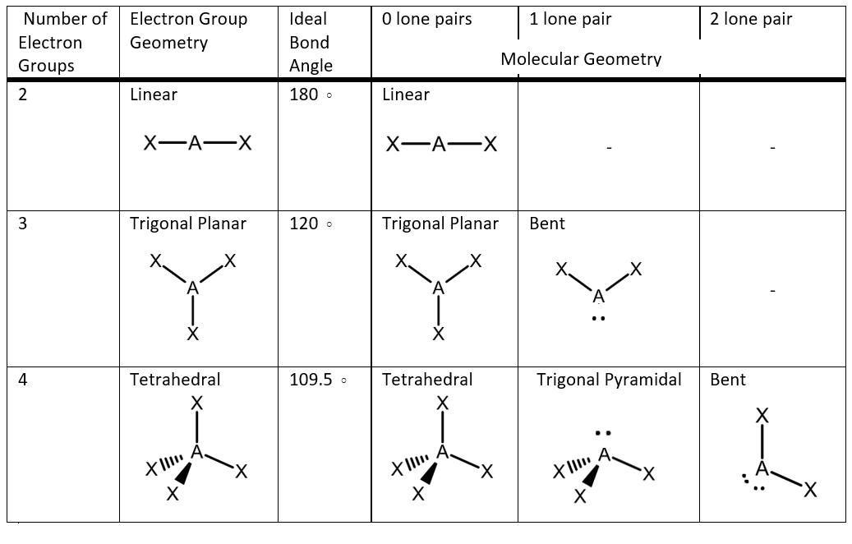
VSEPR Theory Shapes

Slide 6
Lewis Structures
Put the following molecules in order of lowest Boiling Point to highest Boiling Point.
H₂O₂, CO₂, HCN
Lewis
Structures
(Show the bonds in a molecule)
Molecular
Polarity
Step 3
+IMFs
+ EN
Molecule
Shapes
Molecule
Properties

Slide 7
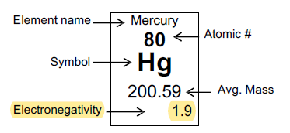
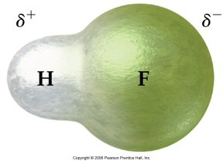
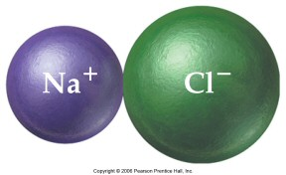
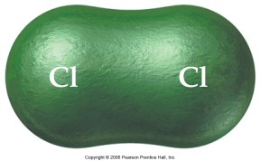
Electronegativity and Bond Polarity
3.0-3.0
= 0.0
4.0-2.1
= 1.9
3.0-0.9
= 2.1
Covalent
Ionic
Pure
Polar
0
0.4
2.0
4.0
Electronegativity difference

Slide 8
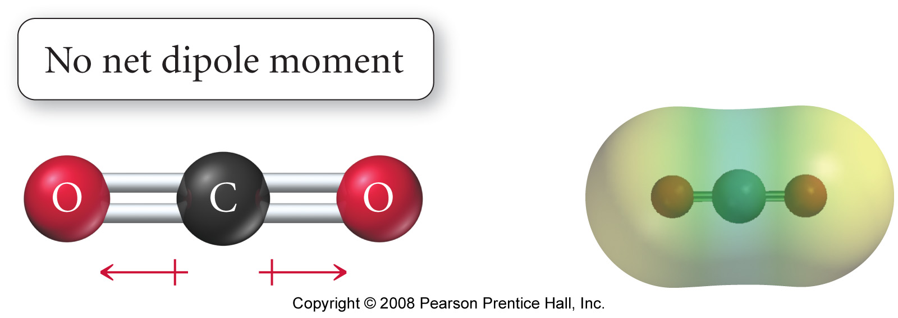
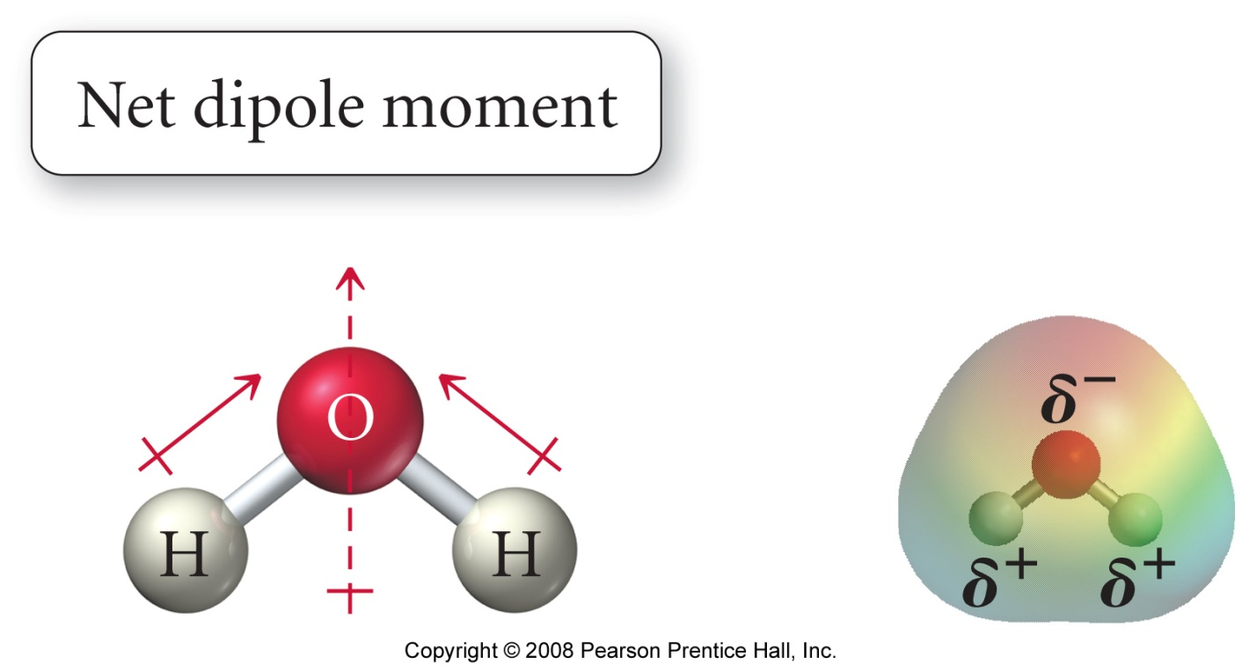
Polarity of Molecules
In order for a molecule to be polar it must:
1. Have at least one polar bond (EN difference > 0.4
Have an unbalanced shape.
(center atom has lone pairs or diff atoms)

Slide 9
Lewis Structures
Put the following molecules in order of lowest Boiling Point to highest Boiling Point.
H₂O₂, CO₂, HCN
Lewis
Structures
(Show the bonds in a molecule)
Molecular
Polarity
+IMFs
+ EN
Molecule
Shapes
Molecule
Properties
Step 4

Slide 10
Types of Intermolecular Forces
Hydrogen Bonding
N-H, O-H, or F-H Bond
Stronger w/ more H-bonds or more EN element
Dipole-Dipole
Polar Molecules
Stronger w/ stronger dipole (more polar)
Dispersion(Induced Dipole)
All Molecules
Stronger w/ larger molar mass
Stronger Attractions

Slide 11
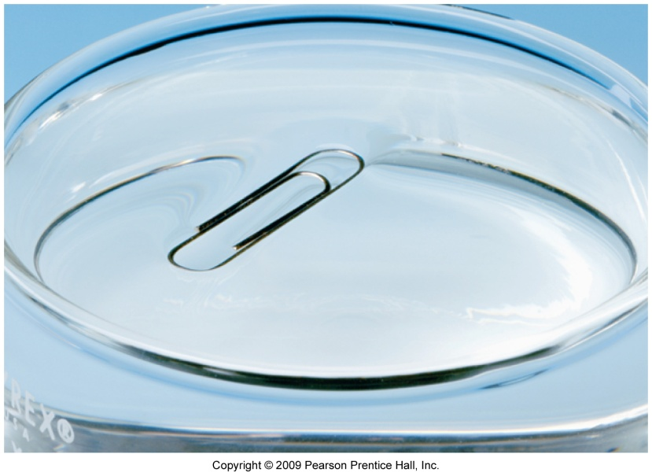
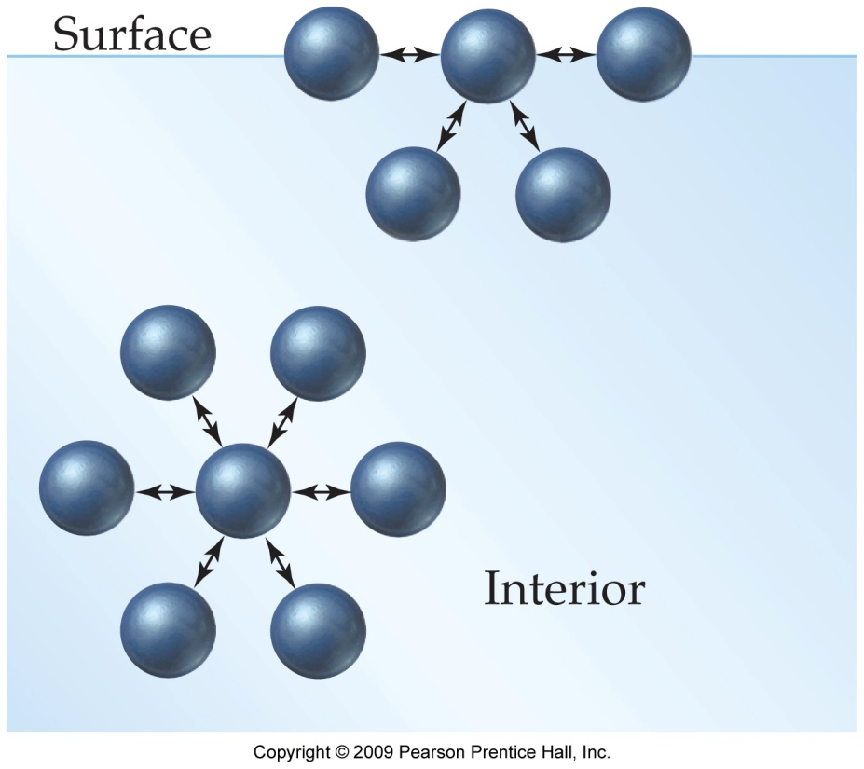
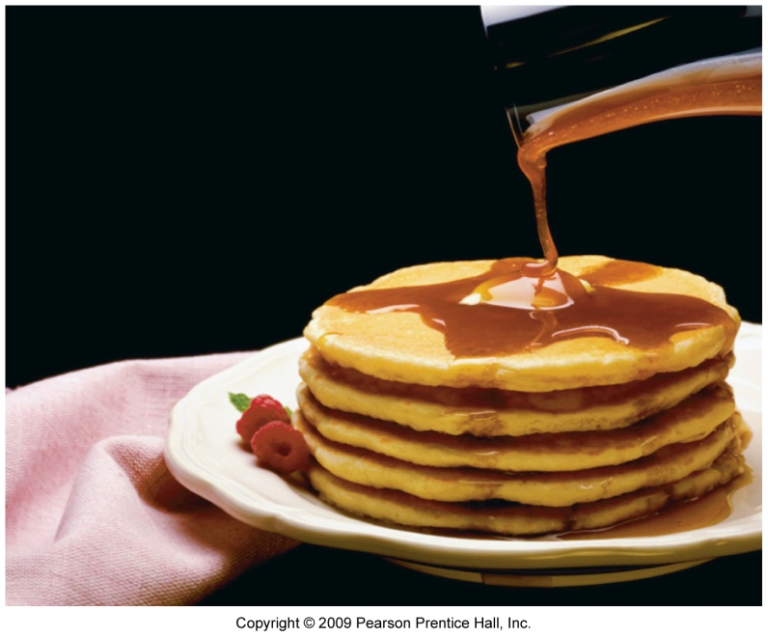
Stronger Attractions give higher…
Melting and Boiling Points
Surface Tension
Viscosity

Slide 12
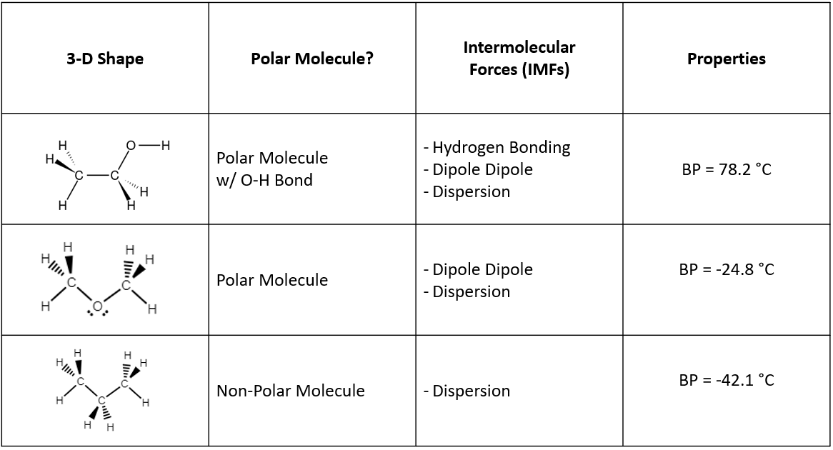
IMF Effects on Physical Properties

Slide 13
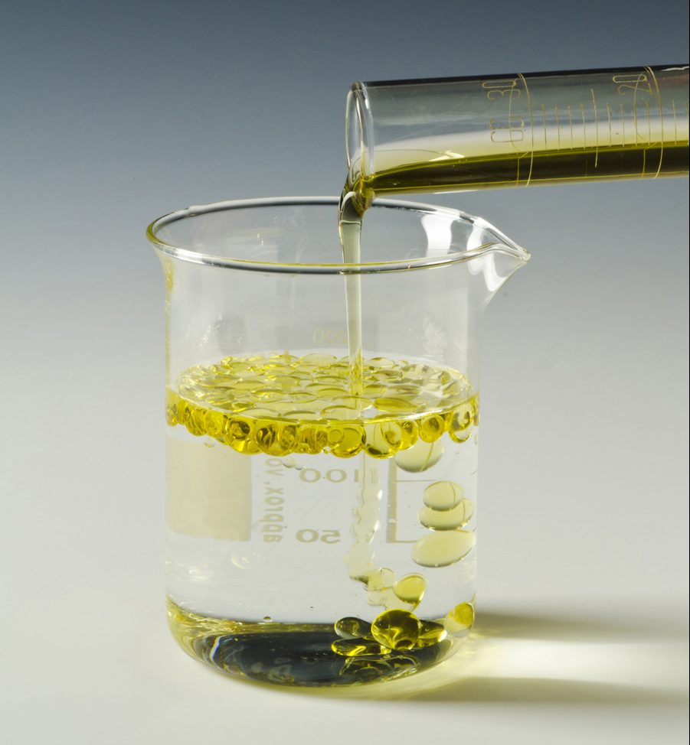
Attractive Forces and Solubility
Like dissolves like.
Miscible = Liquids that do not separate, no matter what the proportions.
Polar molecules dissolve
in polar solvents.
Nonpolar molecules
dissolve in nonpolar
solvents.
Oil and water are “immiscible” do not dissolve/mix in each other
Oil (non-polar)
Water (polar)
This Photo by Unknown Author is licensed under CC BY

Slide 14
Context
Ionic Bonding vs InterMolecular Foces

Slide 15
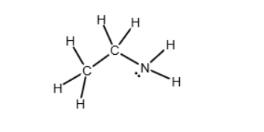
Condensed Structural Formulas
CH₃CH₂NH₂

Slide 16
Step 5: Take a break and reflect
You just went from looking at a chemical formula to being able to predict a lot about a molecule’s physical properties in about an hour!
Also, say a quick “thanks” to Gilbert Lewis ☺

